Slide 1
11.22

Slide 2
Method Details

Slide 3
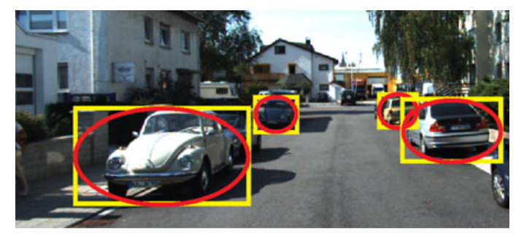
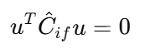
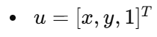
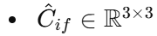
2D Bounding Box to Ellipse
Fit each bounding box to an ellipse shape
Defines the center of the bounding box
Set the axis length of the ellipse (width and height of the bounding box)
Generate a mathematical representation of an ellipse

Slide 4
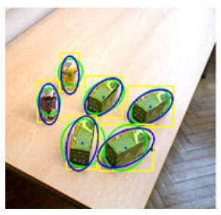
2D Bounding Box to Ellipse
Data preprocessing
Normalization and centering
Ellipse fitting optimization
Calculate the directionality of the object in to introduce the tilt angle 𝜃 (the camera viewpoint, object pose, or angle information in the detection result)

Slide 5
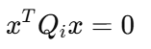
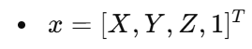
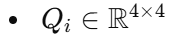
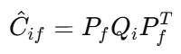
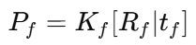
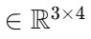
From 2D to 3D
2D Ellipse
3D Ellipsoid
2D to 3D
Nonlinear
Reconstruction into dual space representation (Linear)

Slide 6
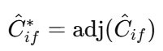
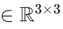
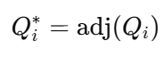
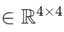
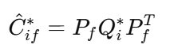
Basic Concept of Dual Space
Dual space represents 2D ellipses and 3D ellipsoids using their tangent lines or tangent planes respectively:
2D:
3D:
Relationship: (Linear)
where adj() is the adjoint operation

Slide 7
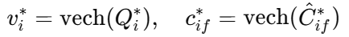
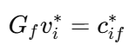
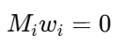
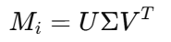
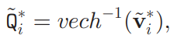
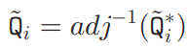
Mathematical solution
Vectorized Matrix: vech() extracts the lower triangular part of a symmetric matrix and flattens it into a vector
Constructing a linear equations:
Solving with SVD:
Stacking all perspectives
G_{f} build from P_{f}
M_{i} build from G_{i} and c*_{if} as
w_{i} build from v*_{i} and scale factor
find V_{min} as solution of w_{i}

Slide 8
Camera Param Extraction

Slide 9
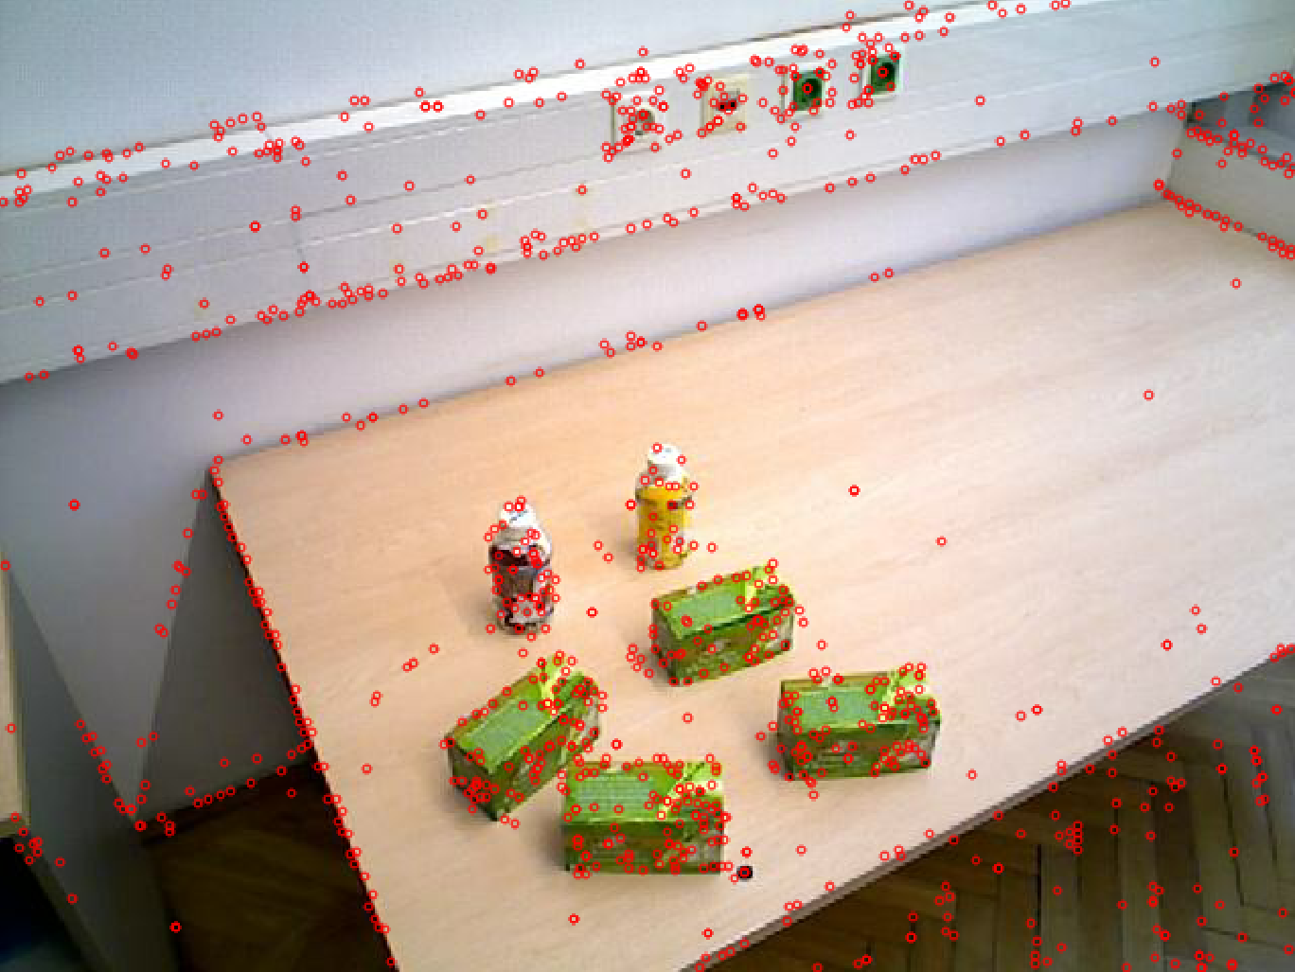
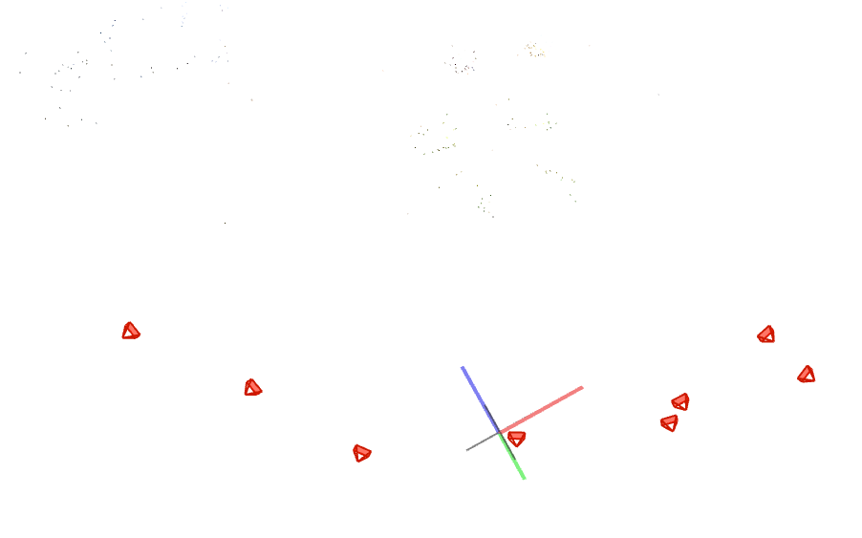
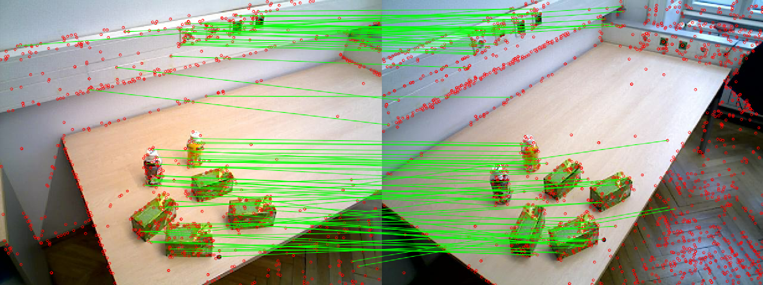
COLMAP
How does COLMAP works?
Keypoints Detection
Feature Match
3D Construction

Slide 10
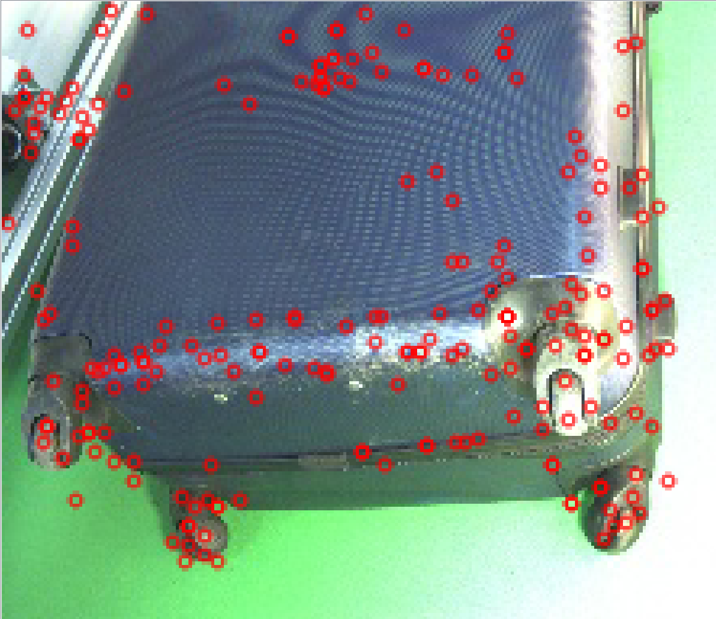
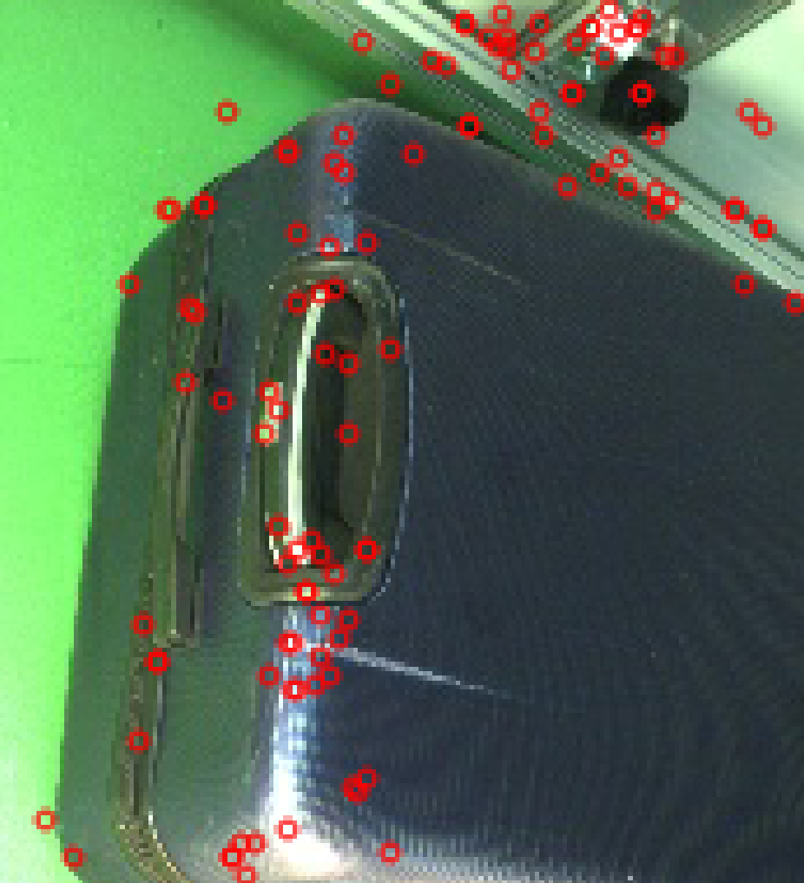
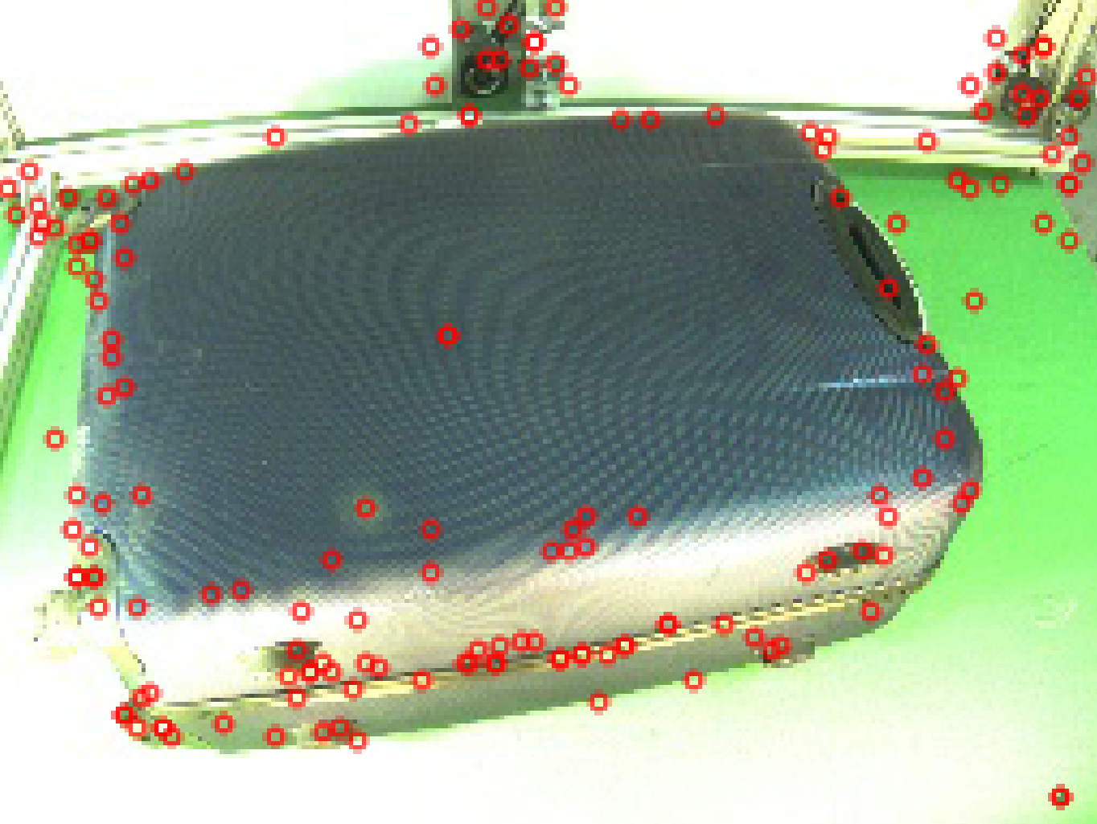
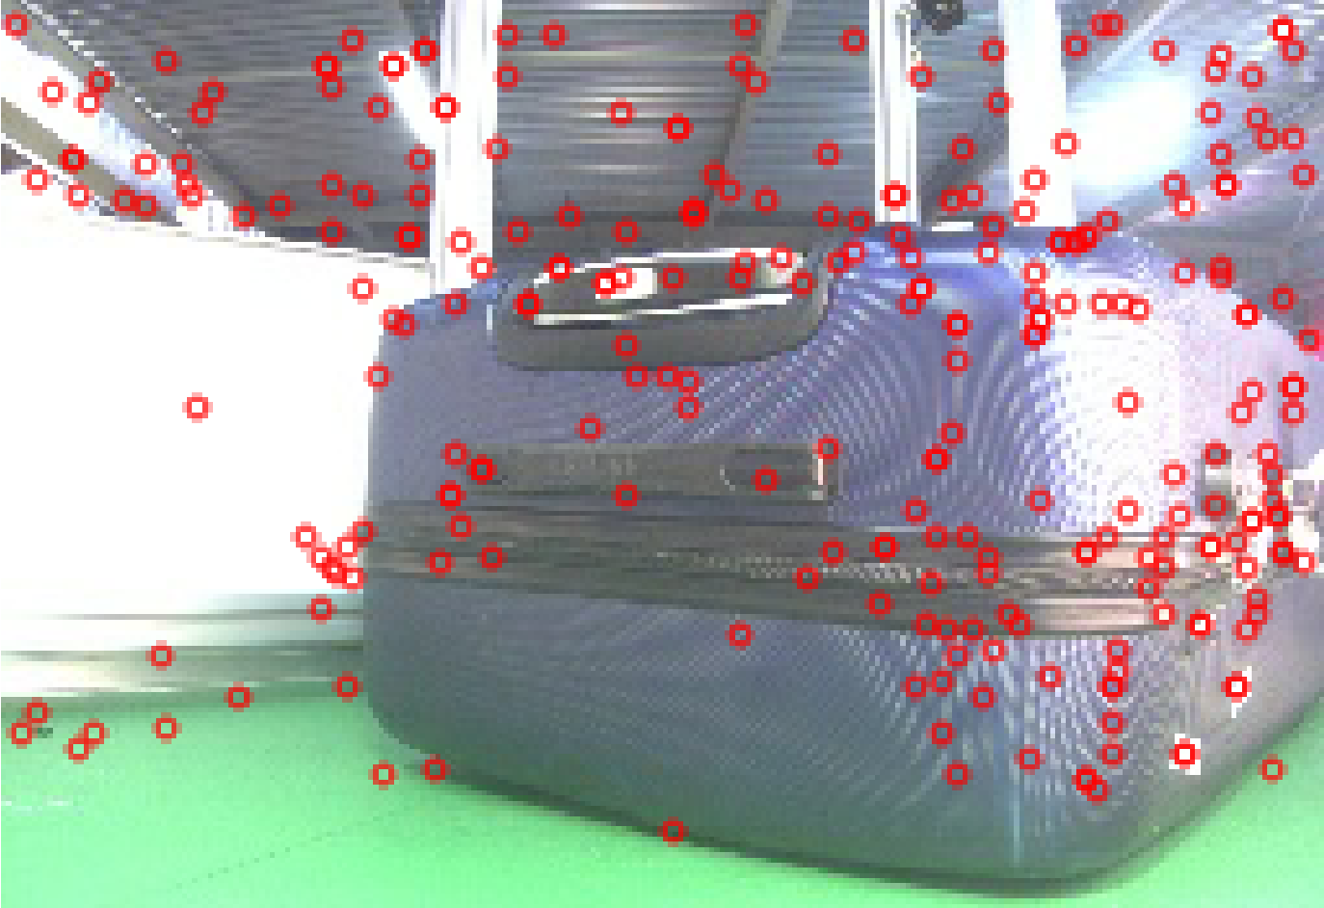
Problem
Too few matching points to reconstruct the 3D scene!
Consider using higher resolution images or increasing the number of images

Slide 11
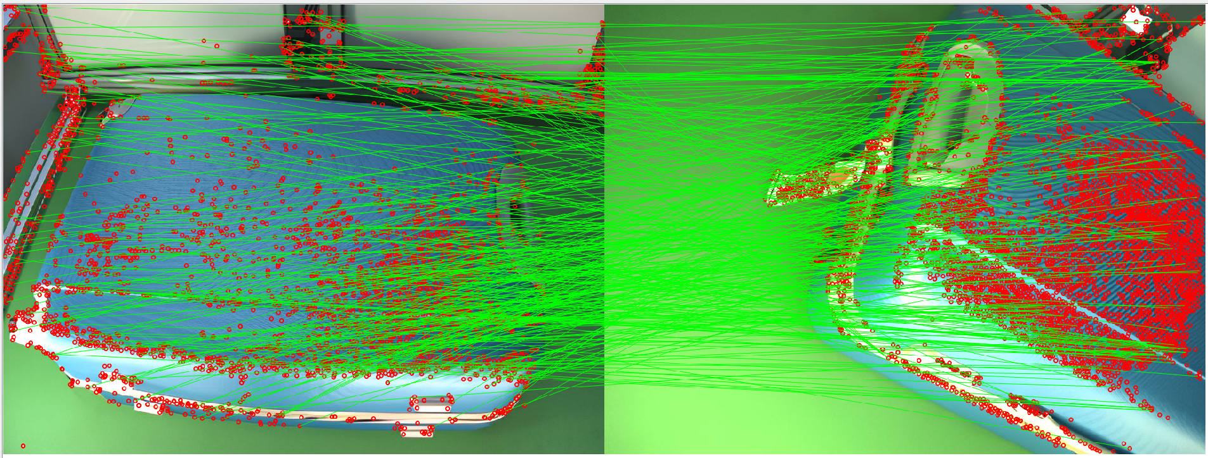
Problem
Try grayscale images and supersampling, but the results were not good (maybe more parameter turning is needed)

Slide 12
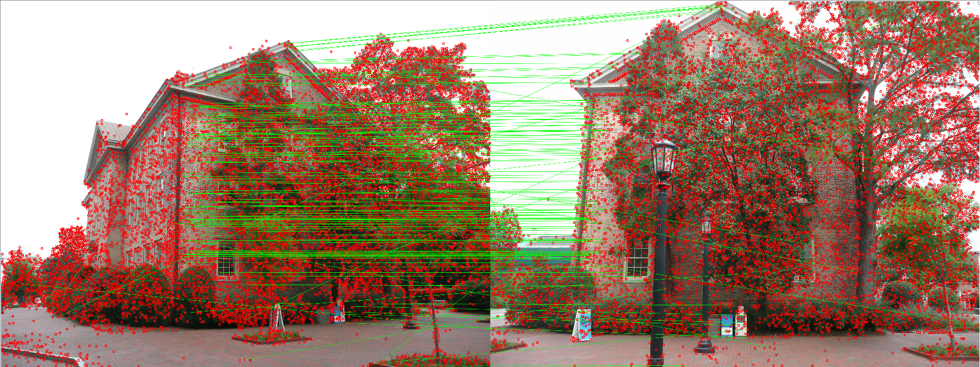
Problem
Example data provided by COLMAP

Slide 13
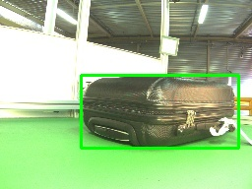
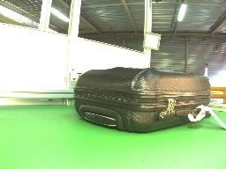
Boundary Boxes
Training-free
Finetuning-free
Only save the largest box
Instant reactions
YOLOv11n may make mistakes, YOLOv11s won’t
YOLOv11s

Slide 14
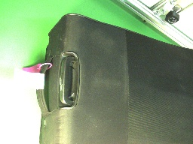
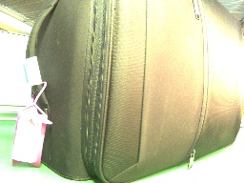
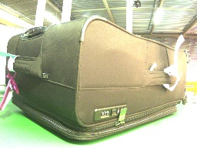
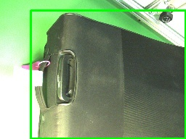
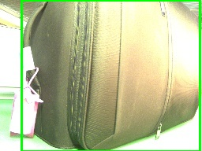
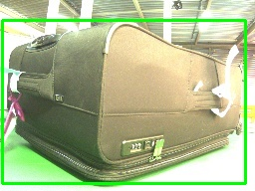
Problem
Not complete in the image
Clear Local Features But …

